Slide 1
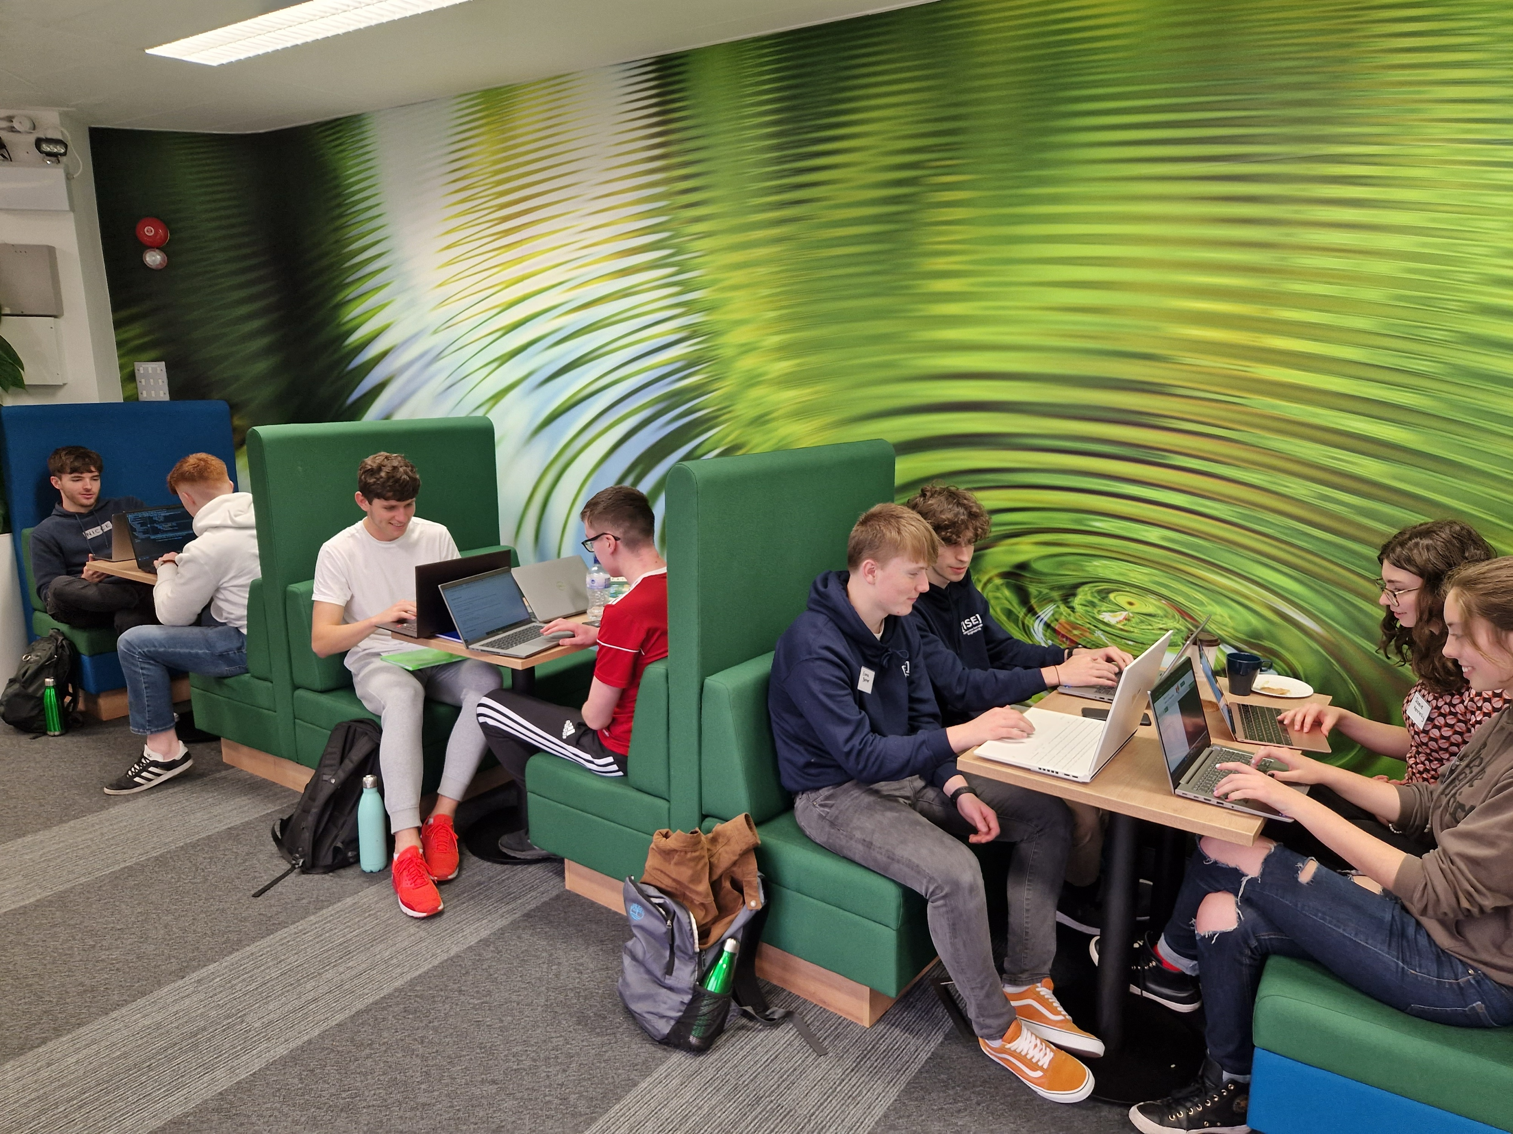
Immersive Software Engineering
BSc/MSc in Immersive Software Engineering [LM173]
software-engineering.ie

Slide 2
LM173
[LM173]
Notes:
SK

Slide 3
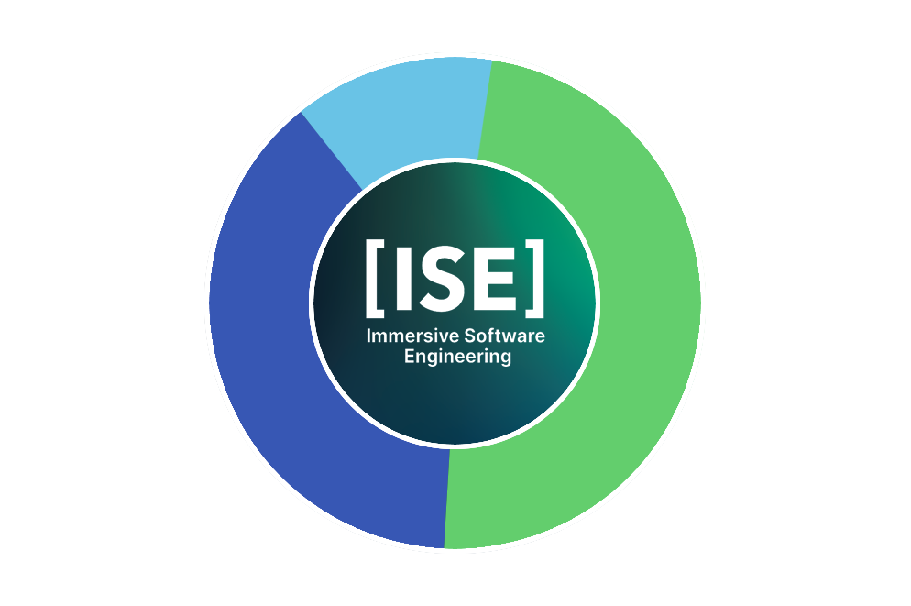
All 5 residencies are paid
Students rotate across different companies for Residencies 1 - 4
Student/Company matching is competitive: Students choose the best companies, companies get the best students
We place two students per Company for Residencies 1 - 3
An MSc in 4 Years
92 weeks studying in UL
73 weeks on paid residencies
25 weeks off
LM173
LM173
[LM173]
Notes:
TM

Slide 4
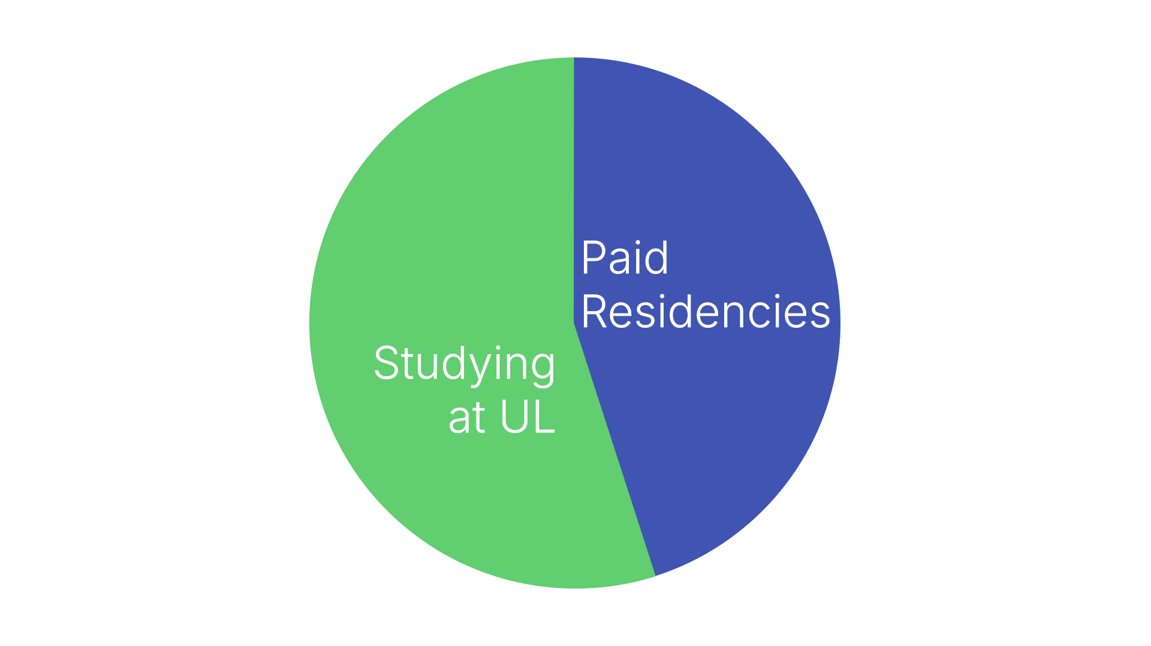
All 5 residencies are paid
Students rotate across different companies for Residencies 1 - 4
Student/Company matching is competitive: Students choose the best companies, companies get the best students
We place two students per Company for Residencies 1 - 3
45% of course time is spent on paid residencies
LM173
LM173
[LM173]
Notes:
TM

Slide 5
All 5 residencies are paid
Students rotate across different companies for Residencies 1 - 4
Student/Company matching is competitive: Students choose the best companies, companies get the best students
We place two students per Company for Residencies 1 - 3
Residencies
All 5 Residencies
are paid!
Students rotate across
different companies for
Residencies 1 to 4
We try to place two students
per company
for Residencies 1
Matching is competitive:
Students choose the best companies,
companies get the best students
LM173
LM173
[LM173]
Notes:
TM

Slide 6
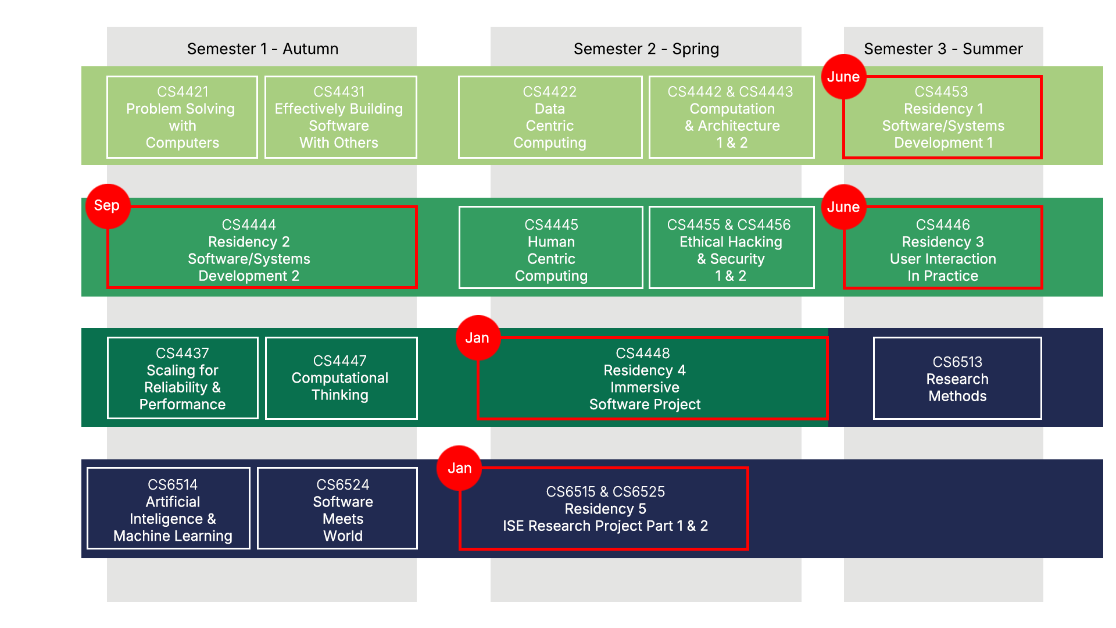
LM173
[LM173]
Notes:
TM

Slide 7
[Current ISE Residency Partners]
Notes:
TM

Slide 8
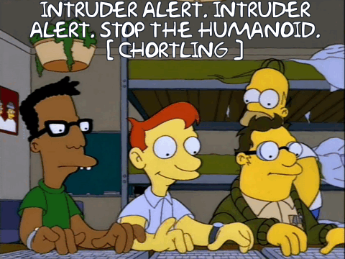
What people think software engineers look like:
LM173
LM173
Notes:
TM

Slide 9
What software engineers actually look like:
LM173
LM173
Notes:
TM

Slide 10
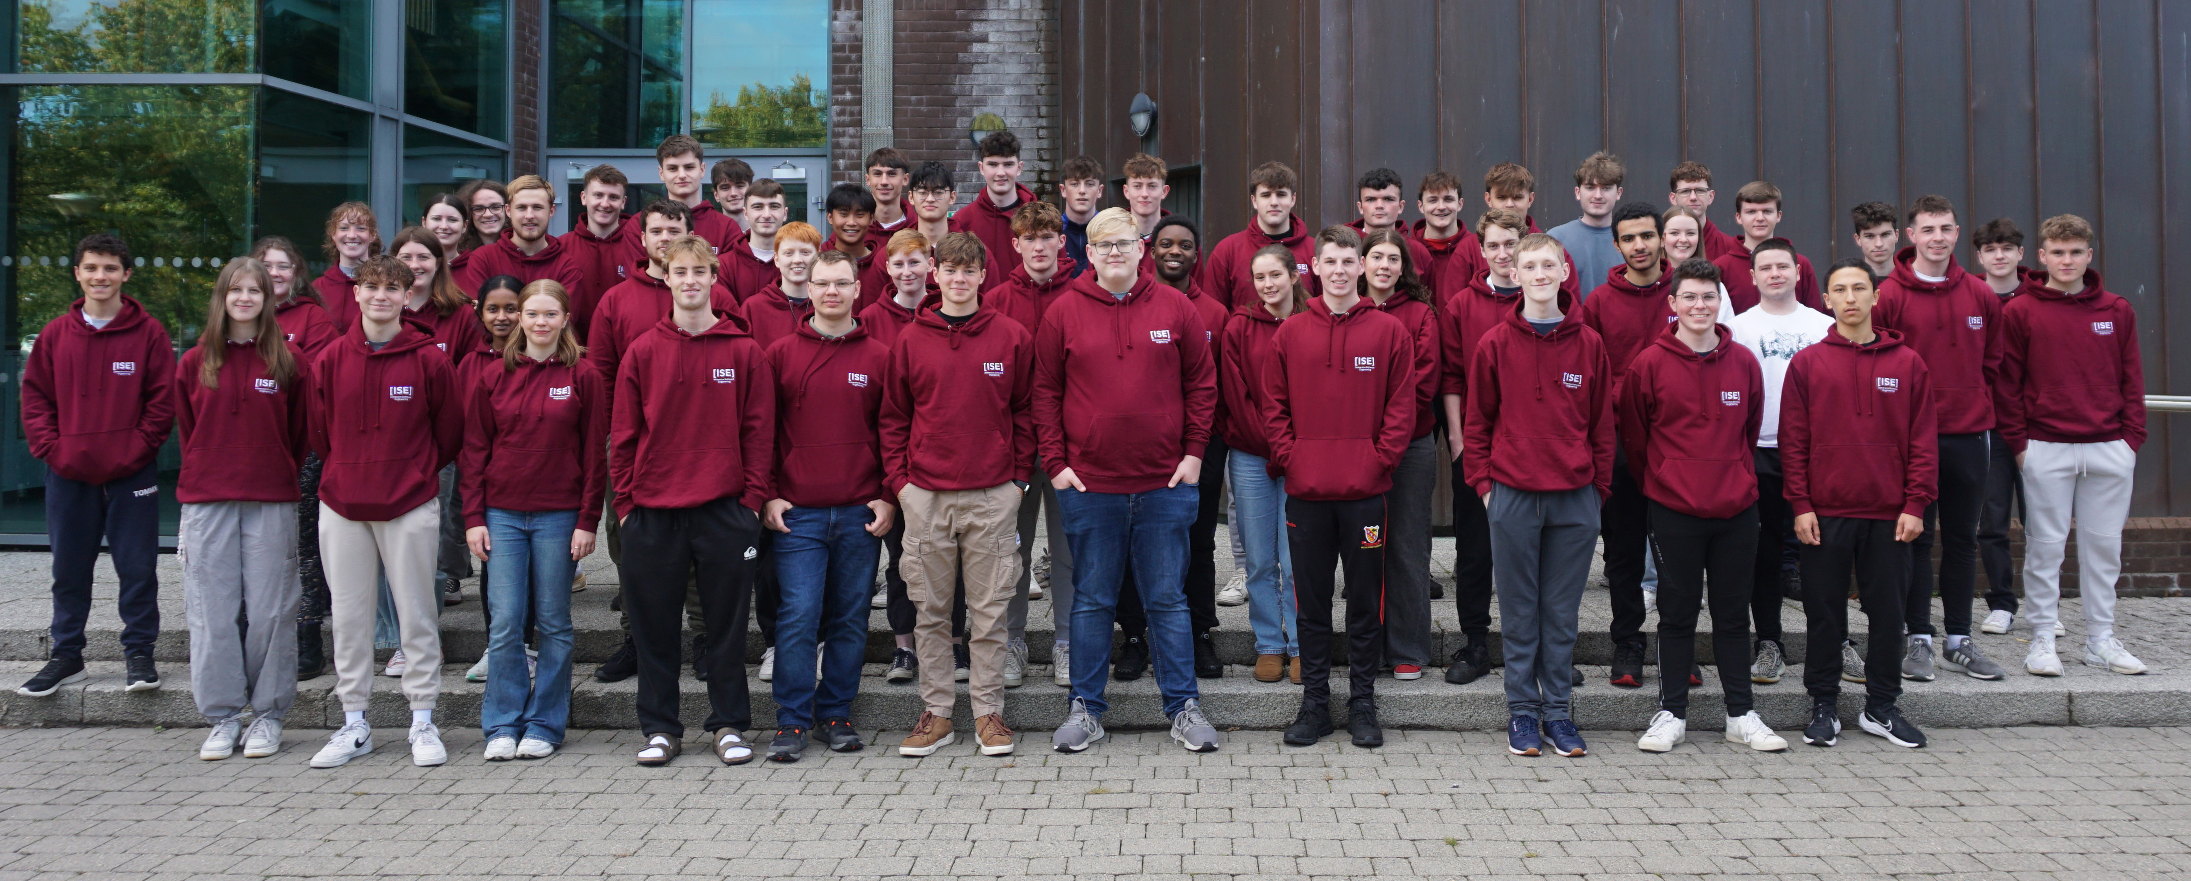
What software engineering students look like:
LM173
LM173
Notes:
TM

Slide 11
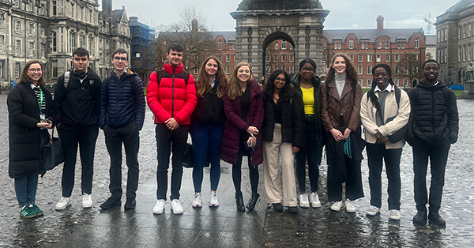
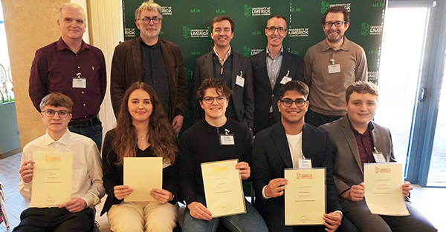
Student Achievements
Trinity Gen AI for good – 1st, 2nd, 3rd – 50% shortlisted were ISE
UL Junior Entrepreneur of the year – 2 years running
National Social Innovation Competition – 1st place + runner up
Open Incubator Overall Challenge – 3 ISE teams won
LM173
[LM173]
Notes:
In February a group of first years students travelled to Trinity College Dublin for the Tangent Gen AI good innovation challenge. ISE won three of the prizes which included the overall winners. Winners were second year students Karl Gilmartin and Dara Newsome and there start up ‘Streetwise’ which is a mobile app the creates safety in our community!
50% of the shortlisted winners of the Gen AI competition for good were ISE students!
For the second year in a row, the University of Limerick Entrepreneur of the year was won by an ISE student. Justyna Przyborska (first year) won with her idea called ‘Little Footprints’.
Congratulations to 2 ISE teams - 1. Brand Trace (Dominik Stephens 2nd Yr ISE) and 2. Releaf (Thomas Joyce and Dara Heaphy - 1st year ISE) who got through to the final of the national Social Innovation competition and to Thomas and Dara who won 1st place!! The competition was run by the Open Incubator and Roisin Lyons (UL). Judges were Joe Gorman (Dogpatch), Katie Mahon (Logitech) and Alan Costello (Resolve Ventures). The winning concepts is an open-source mapping tool to help report, log and forecast ash dieback in Irish woodlands. They won €1000!! This is their second competition win this semester, for two different start-ups.
Three of our ISE Teams were winners of the Open Incubator Overall Challenge and will receive funding of between €250-2000 for their startup ideas - Eoghan Murphy (Y2), Laochra (Y1 - Dara & Thomas), and a speaker award for Patrick Murphy (Y1).

Slide 12
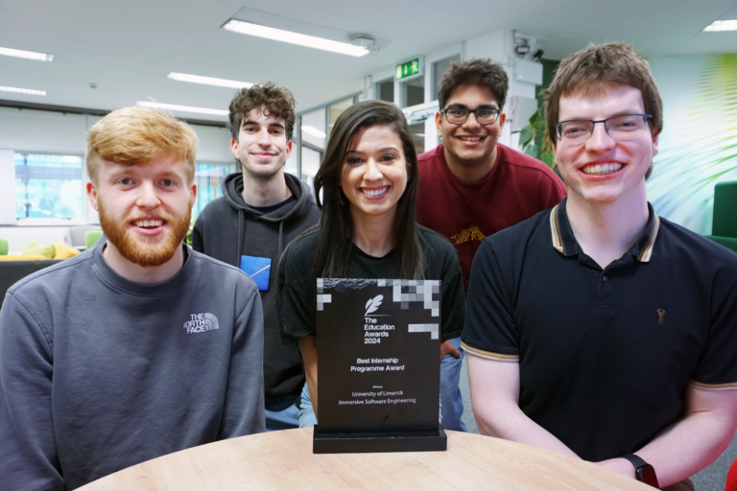
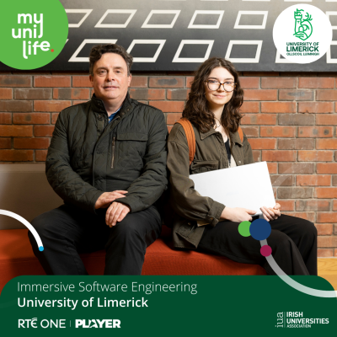
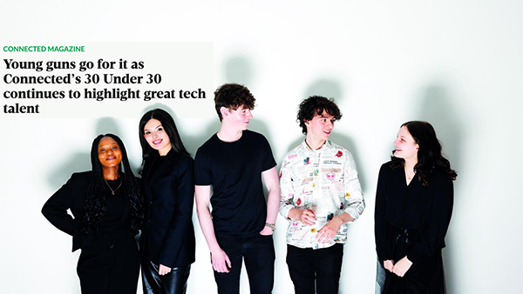
ISE
Technology Ireland Industry award for outstanding academic achievement
Best Internship Programme – The National Education Awards 2024
ISE/ Rosie Kennelly on My Uni Life – RTE
2 ISE Staff in the 30 under 30 in Tech Talent
LM173
[LM173]

Slide 13
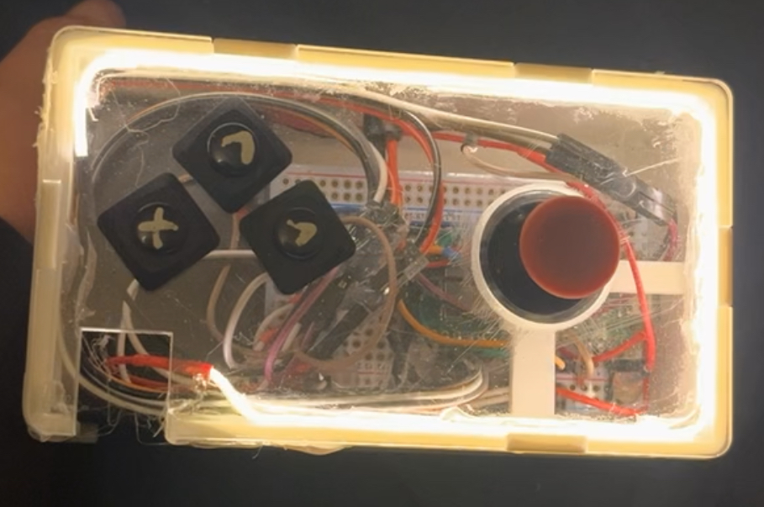
What you will learn
Coding Languages – Python, Java, GoLang, C++, etc.
Full Stack Development
Arduinos - single-board microcontroller for building digital devices
Artificial Intelligence
Cloud computing
Ethical Hacking
Operating Systems
Data Structures & Algorithms
Containers
Professional Development
Teamwork
It uses 2 Raspberry Pi Pico W, one in the Pokémon and one in the controller and they talk over wifi. Raspberry Pi Pico W are very cheap (€4-6) and are a great place to start learning coding and electronics if any students want to learn more
It has three motors, one in each foot and one in the tail.
I also had lights in the mouth and servo motors in the arms.
The Pokémon was 3D printed, and then sanded, glued and painted.
The controller uses a thumbstick to control the Pokémon, and has three buttons for the arms and lights.
All the code is written in Python
[LM173]
LM173
LM173
Notes:
TM

Slide 14
Problem Solving
[LM173]
LM173
LM173
Notes:
TM

Slide 15
Entry Requirements
Leaving Certificate
Leaving Certificate (or an approved equivalent) with a minimum of two H5, and four O6 or four H7 grades.
Subjects
A minimum grade H4 in Mathematics.
Irish or another language (unless exempt)
A Special Mathematics Examination will be offered at UL following the Leaving Certificate results if you did not achieve the Mathematics requirement.
Entrance Submission
All applicants must submit an entrance submission.
May be called for an interview.
Worth 200 points on top of 625 max from Leaving Certificate.
CAO Points:
676 in 2024 (Including entrance submission out of 825)
LM173
LM173
[LM173]
Notes:
TM Applications from mature students are welcome. Mature applicants must apply through the Central Applications Office (CAO) by 1 February 2023.

Slide 16
Entrance Submission
Students will receive an email from UL admissions with a link to a submission site the first time they select LM173 Immersive Software Engineering on the CAO – each applicant will only receive this link once
International students who apply directly to UL for the LM173 BSc will likewise receive an email with a link.
Ask students to please check spam filters etc. to make sure they do not miss this email; it will not be re-issued in later submission rounds
200 Points
Show us your skills and interests related to science, technology, engineering, math, and innovation, in a way that connects with you
Please read the details for each route carefully before choosing ONE route to respond to.
Route A - Technology Project
Tell us about the most creative, interesting, or enjoyable way in which you have used technology.
Route B - Personal Profile
Help us to understand you based on your experience and insights by crafting responses to a series of questions.
Please include screenshots, photos, news articles and links to repositories or portfolios, website URLs, or any other artefacts which can support your answer.
LM173
LM173
[LM173]
Notes:
Timeline is on upcoming slide

Slide 17
Option A – Technology Project
Students will receive an email from UL admissions with a link to a submission site the first time they select LM173 Immersive Software Engineering on the CAO – each applicant will only receive this link once
International students who apply directly to UL for the LM173 BSc will likewise receive an email with a link.
Ask students to please check spam filters etc. to make sure they do not miss this email; it will not be re-issued in later submission rounds
200 Points – Max 800 words
Using technology doesn’t have to mean writing a computer program – it could be any situation in which you’ve used any technology to do something interesting.
We want to know what you did, but we’re also very interested in how you did it.
Overview of your Work
Project Impact
(see website for full instructions)
LM173
LM173
[LM173]
Notes:
Timeline is on upcoming slide

Slide 18
Option B – Personal Profile
Students will receive an email from UL admissions with a link to a submission site the first time they select LM173 Immersive Software Engineering on the CAO – each applicant will only receive this link once
International students who apply directly to UL for the LM173 BSc will likewise receive an email with a link.
Ask students to please check spam filters etc. to make sure they do not miss this email; it will not be re-issued in later submission rounds
200 Points – Choose 3 of the 4 Questions listed (Max 400 words per question)
Do you have a talent or interest that is highly important to you? Tell us about this aspect of your identity and your key accomplishments in this area.
Tell us about a time you solved a problem. How did you identify and test the solution?
Do you have a background in computer science and/or software development? Tell us about your key accomplishments in this area.
ISE students work on projects that are truly innovative. Pitch, in some detail, a new project you would like to work on as an ISE student. Think big – we like a challenge!
LM173
LM173
[LM173]
Notes:
Timeline is on upcoming slide

Slide 19
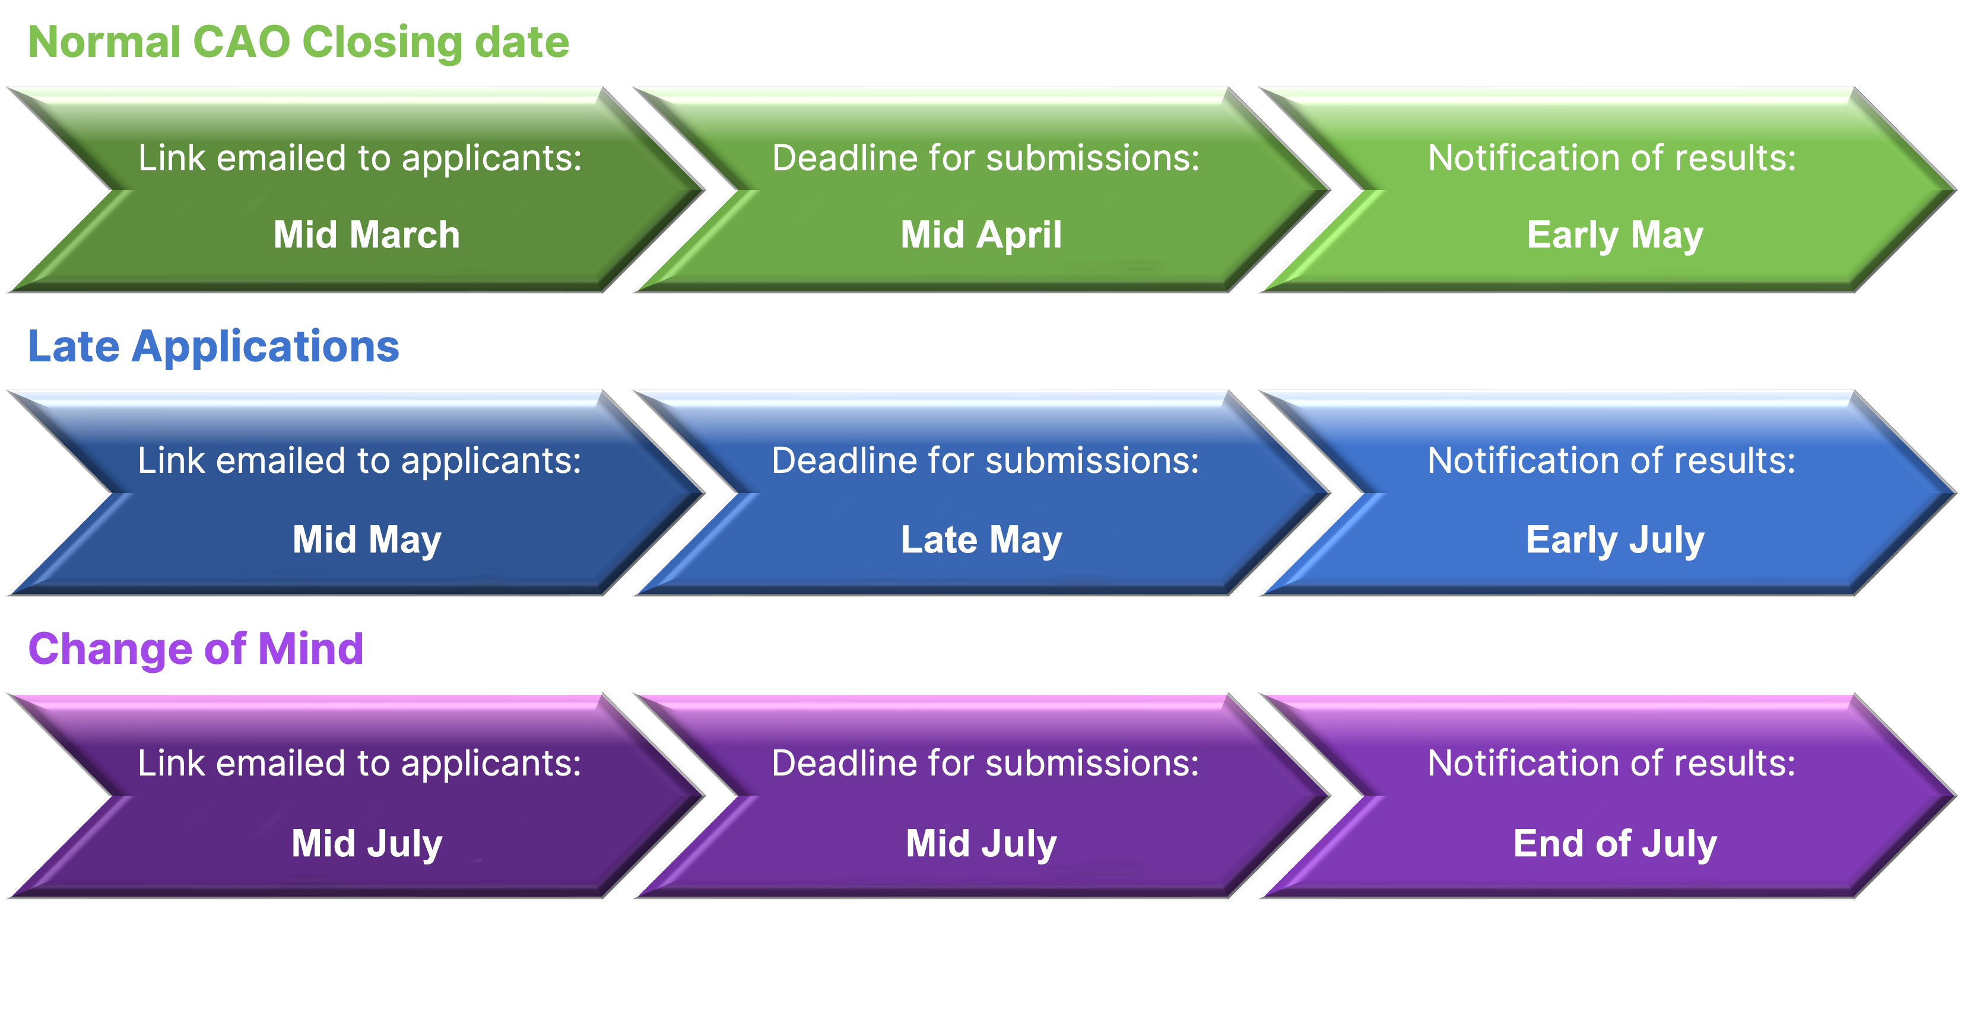
CAO/ Entrance Submission Timeline
*Please see ISE website for specific dates and instructions
LM173
LM173
[LM173]
Notes:
https://www2.cao.ie/downloads/documents/2025/CAO_Important_Dates.pdf
https://www.immersive-se.ie/about-the-ise-entrance-submission/

Slide 20
 | CSIS Undergraduate Courses
Title | Computer Science (Common Entry) | Immersive Software Engineering | Artificial Intelligence & Machine Learning
Course Code | LM121 | LM173 | LM174 (from 2022 on)
Specialities (2nd- 4th year) | Computer Systems Comp. Games Development Cyber-Security & IT Forensics | Software Engineering from the start | AI/ML from the start
Theme | Broad-spectrum software development | Accelerated, immersive software engineering | Artificial Intelligence, Machine Learning, Data Science
Features | Choose speciality at end of year 1 Traditional academic calendar Data Analytics & AI/ML streams Coop Year 3 | Block-based, 5 residencies in industry, Accelerated | First of kind in country; Traditional computer topics and coop included. Traditional academic calendar
Qualification | BSc | MSc | BSc/MSc
Structure | 2 semesters per year for 4 years | 3 semesters per year for 4 years | 2 semesters per year for 4 years BSc 1 additional year for MSc
Contact Person | J.J.Collins@ul.ie | J.J.Collins@ul.ie | Patrick.Healy@ul.ie
Website | https://www.ul.ie/courses/computer-science-common-entry | www.software-engineering.ie | https://www.ul.ie/courses/bachelormaster-science-artificial-intelligence-and-machine-learning
Chris.Exton@ul.ie
Patrick.Denny@ul.ie
LM173
[LM173]
Notes:
TM

Slide 21
Thank you – Q&A
software-engineering.ie
BSc/MSc in Immersive Software Engineering [LM173]
@Immersivesoftwareengineering
@ImmersiveSE
@Immersivesoftwareeng

