Slide 1
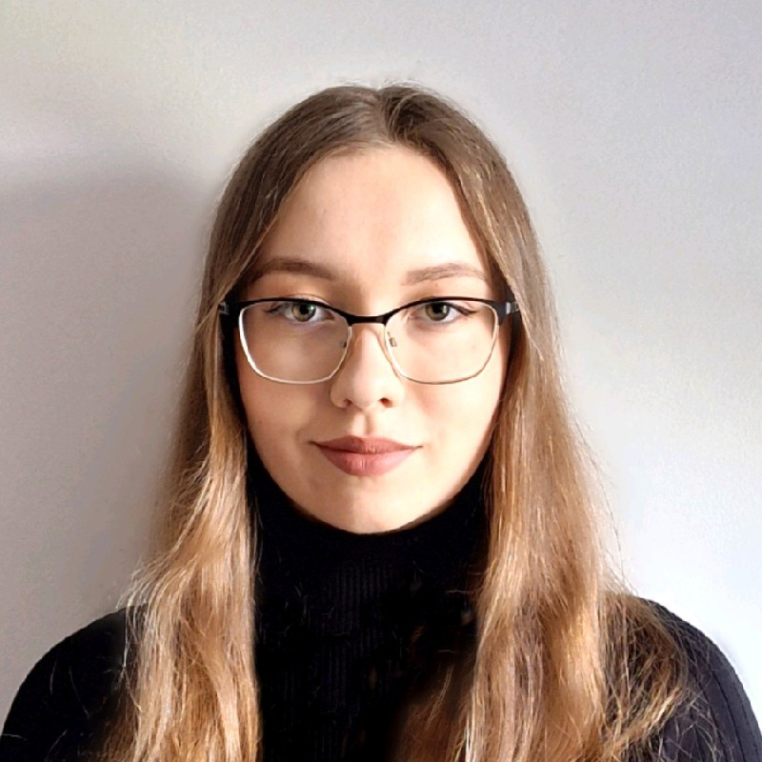
UL Entrepreneur of the year 2024
Justyna Przyborska

Slide 2
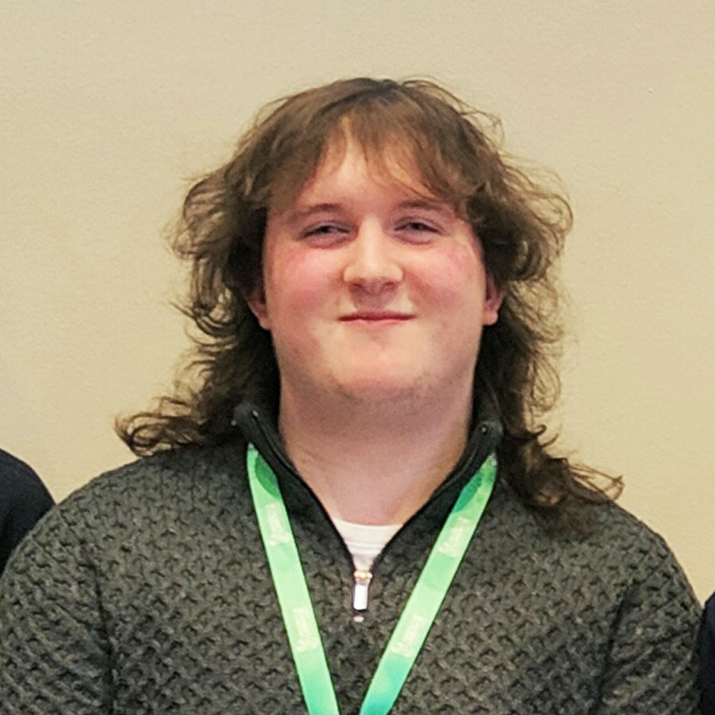
UL Entrepreneur of the year 2023
Dara Newsome

Slide 3
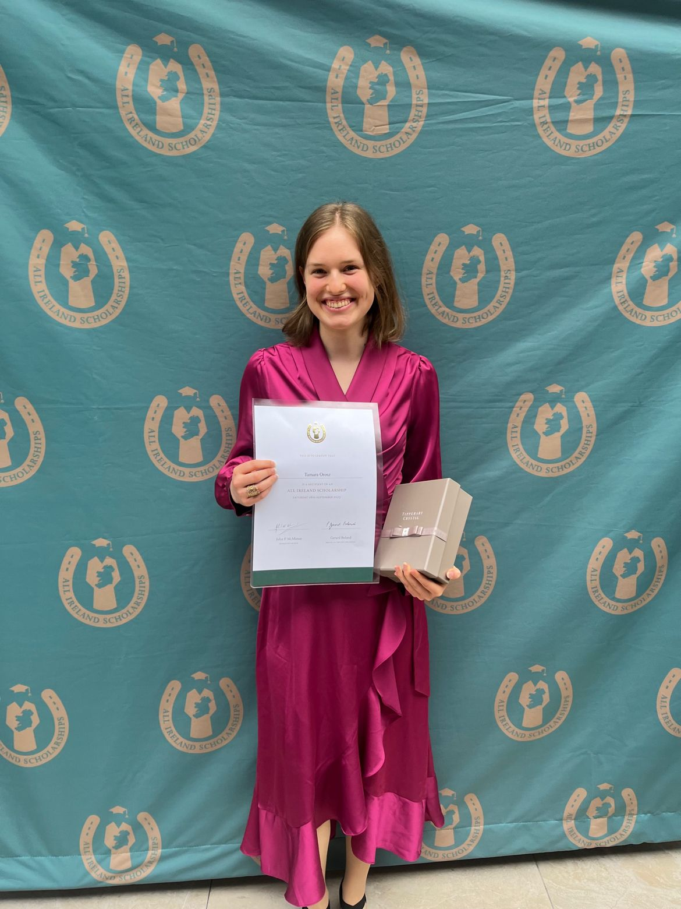
JP McManus Scholarship
Tamara Orosz
3rd Year
Tamara
JP McManus
All Ireland Scholar 2023

Slide 4
Education Awards
BEST INTERNSHIP
PROGRAMME 2024

Slide 5
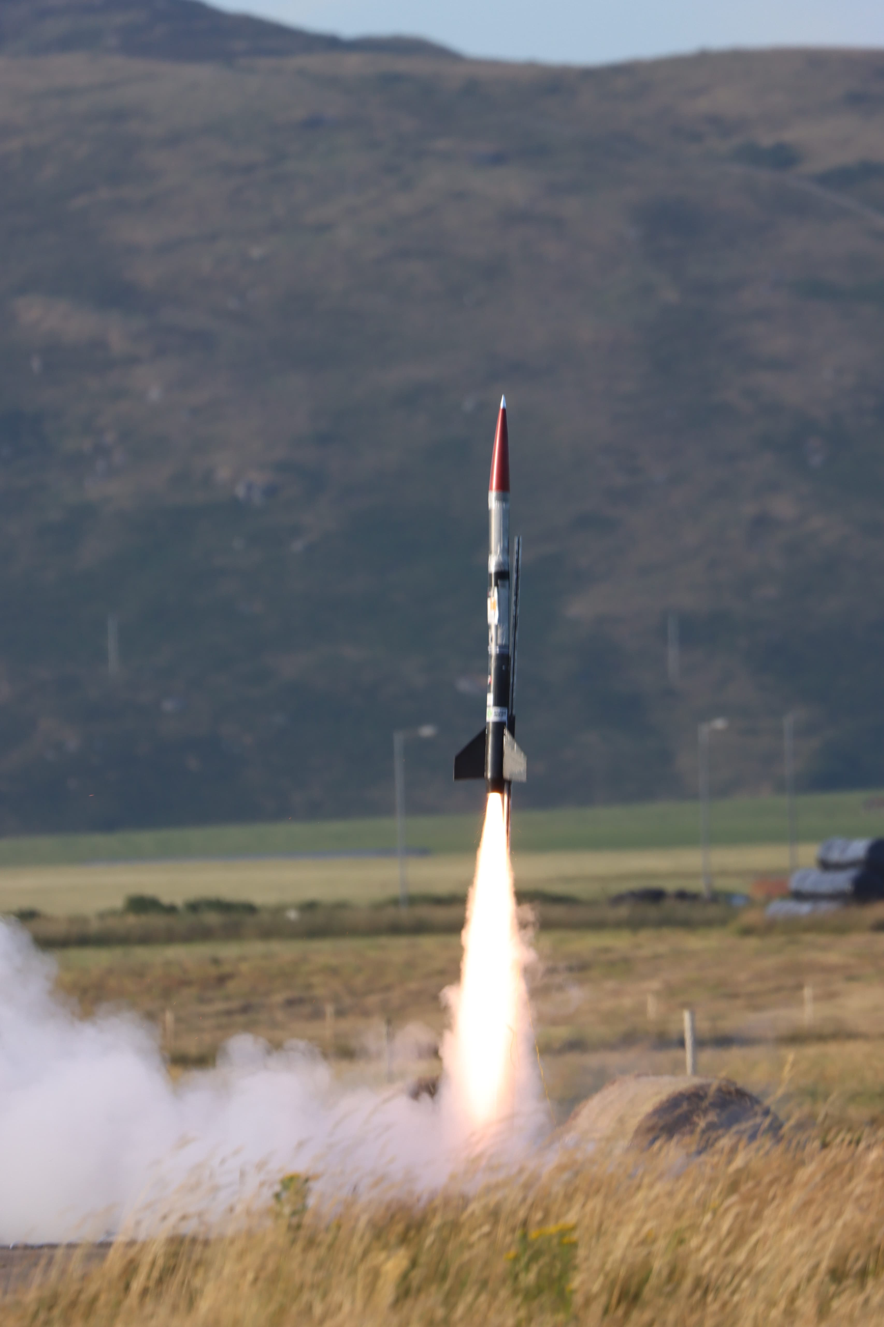
Several ISE students participate in University of Limerick Aeronautical Society High Powered Rocketry Team.
This year, ULAS HiPR participated in the European Rocketry Challenge (EuRoC) in Ponte de Sor, Portugal, proudly representing Ireland as the first and only Irish team at the competition.
The team achieved an impressive 5th place in the payload category, a significant accomplishment for the young team operating with limited resources.

Slide 6
The Generation Google Scholarship is for women in computer science in Ireland. It was established to help aspiring computer scientists excel in technology and become leaders in the field.

Slide 7
My Uni-Life

Slide 8
Zerve Hackathon

Slide 9
Jamie Heaslip panel with ISE students at Asia Matters 2024: Driving Digital Innovation to Grow Global Business

Slide 10
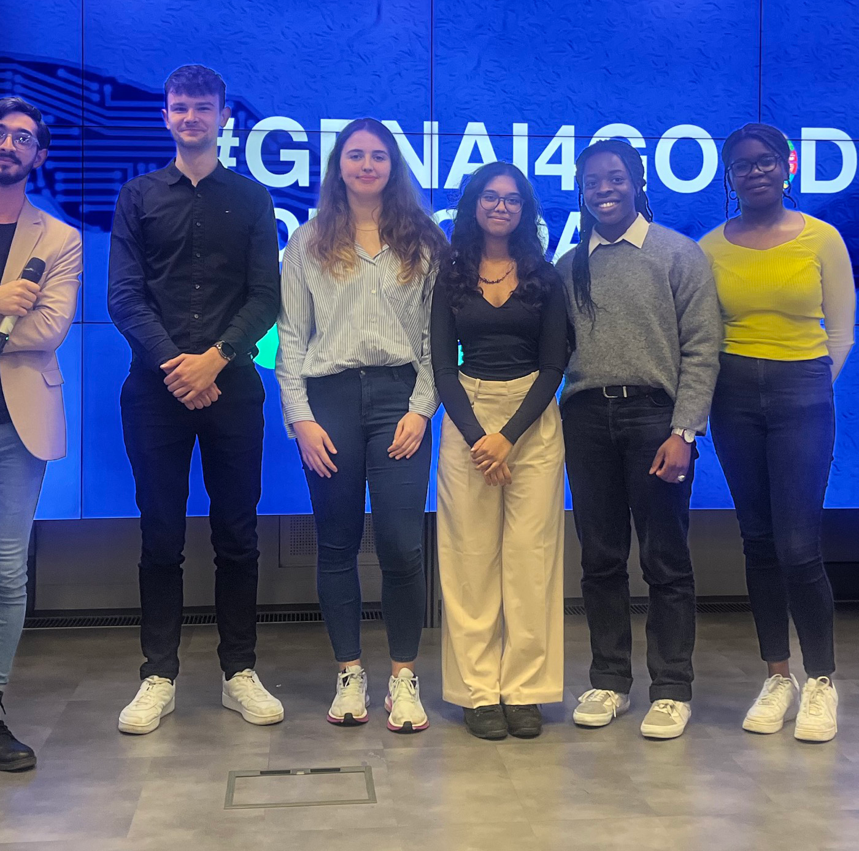
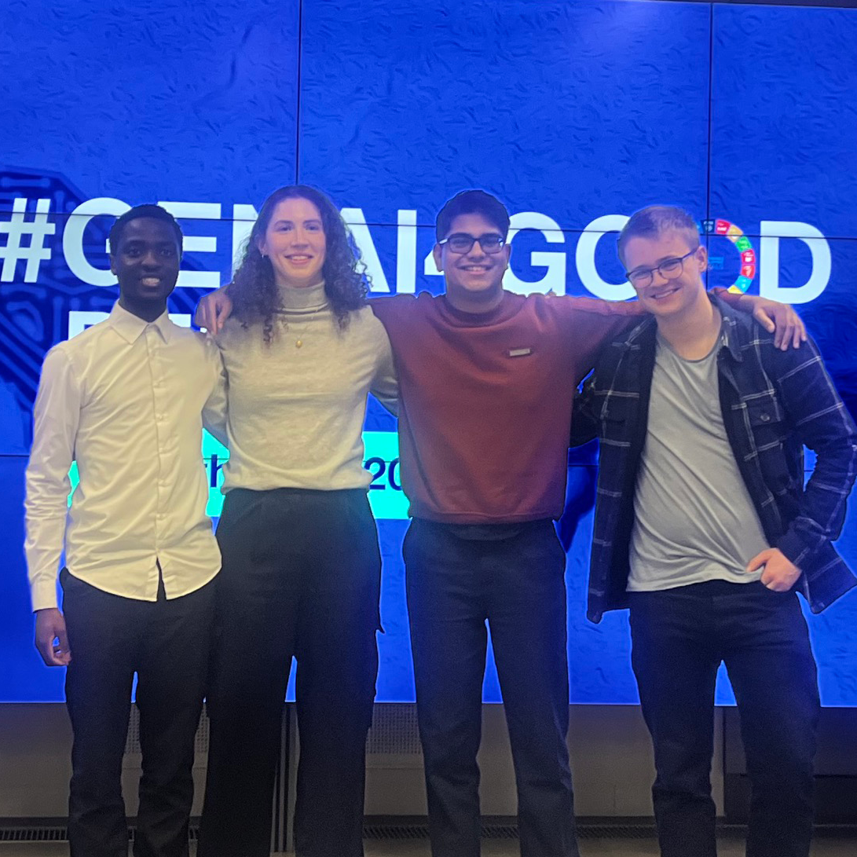
ISE teams claim top 3 places at TCD Tangent’s Generative AI for Good Innovation Challenge
1st
StreetWise
2nd
Med Connect
t
3rd
Traffix

Slide 11
Rosie Scale Ireland
ISE student Rosie Kennelly speaking at
Scale Ireland Regional Start-up Summit 2024

Slide 12
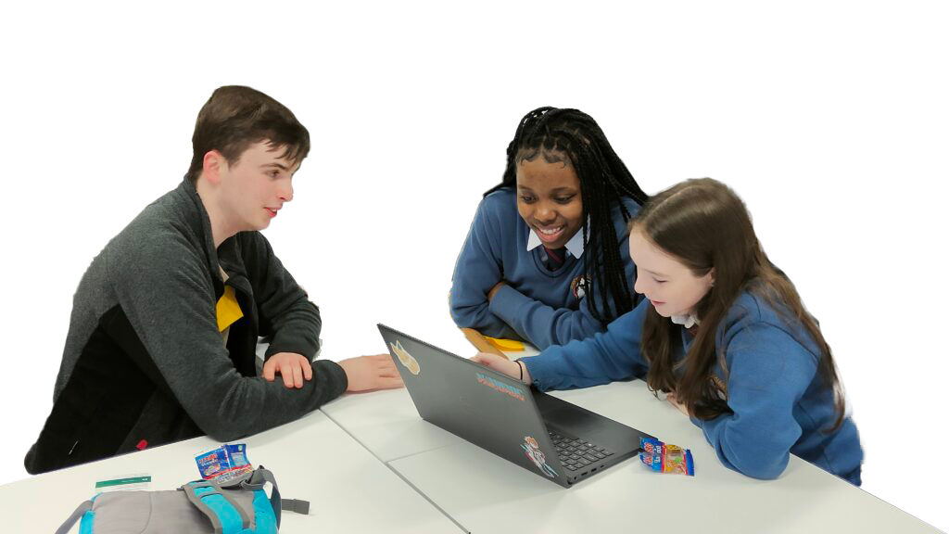
Secondary School Mentoring
ISE students mentor second-level students one-on-one and
create engaging content that sparks curiosity and inspires
the next generation of innovators

Slide 13
30 under 30:
The bright young stars of Ireland’s tech scene
Jack O’ Regan Kenny – ISExAWS Fellow, Entrepreneur and Engineer
Jack joined the ISE team through our fellowship programme in partnership with AWS. Jack is a serial entrepreneur having founded two startups in his teens. He has also served as MD of the Patch Accelerator. Jack is committed to supporting the tech community in Ireland, particularly with respect to entrepreneurship and innovation. He is currently teaching in ISE as part of his fellowship.
Josh McGiff – ISE Lecturer, Founder & Community Leader
Circled in picture, Josh is Head Instructor on the ISE programme and is currently pursuing a PhD in AI. His passions lie with revolutionising the way people learn about software engineering and machine learning. Josh is also the founder of the Twitch Ireland community and Streamably (his business that supports creators thorugh providing them with an array of tools and supports).

Slide 14
Robocode
Games Fleadh Robocode Ireland Challenge 2023 runners-up
Dervla Gargan
Art Ó Liatháin
Daniel J. Kennedy

Slide 15
Givebackathon
In May 2024 ISE students provided tech support to a number of charities free of charge. They created a website, improved web services and designed an app in conjunction with good causes from Limerick

Slide 16
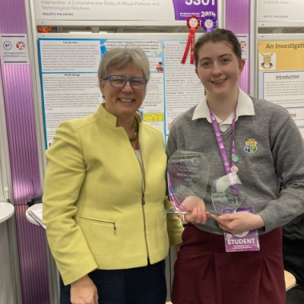
Aoibheann Mangan
BT Young Scientist:
The Health Research Board Award
For Enhancing Inhaler Technique Proficiency and Adherence in Pediatric Asthma Patients through Machine Learning-Based Intervention: A Comprehensive Study of Misuse Patterns and Technological Solutions

